Slide 1

High level design presentation
Roy Toledano | Idan Shalom | Ronen Gelmanovich

Slide 2
Premise

Slide 3


Premise
The motivation
Currently, there's a lack of a unified solution for community driven polling.
The solution
Providing a platform for a wide range of survey needs for community decisions.
The implementation
Sympoll is an online surveying platform designed for scalability using Kubernetes. It is a versatile platform that makes surveys easier and accessible in different situations and social circles.

Slide 4
Main features

Slide 5

Main features
Sympoll's main function is letting users create groups and survey them easily.
Completed surveys are stored in Sympoll for later reference, keeping everything organized.
Sympoll sends users updates about new surveys in their groups, important messages, and other events.
Users can customize their profiles with pictures and personal info, making the platform more personal and engaging.

Slide 6
High level design

Slide 7
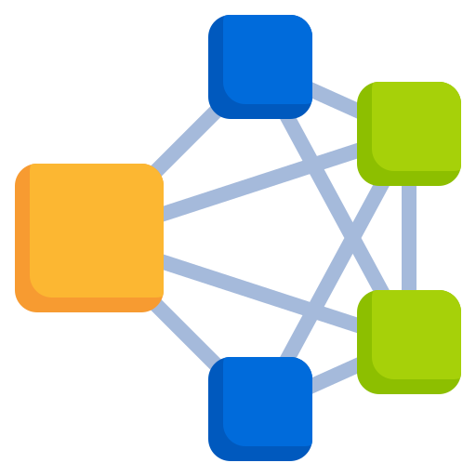
High level design
Sympoll is a web app, accessed from a browser.
The frontend on the browser side sends requests to the backend services.
Backend services are separate and communicate via HTTP in order to fulfil the user’s request.
Data is stored and provisioned from a DB accessible to all backend services.
This sort of interaction is easily allowed by deploying these services in a Kubernetes cluster.

Slide 8
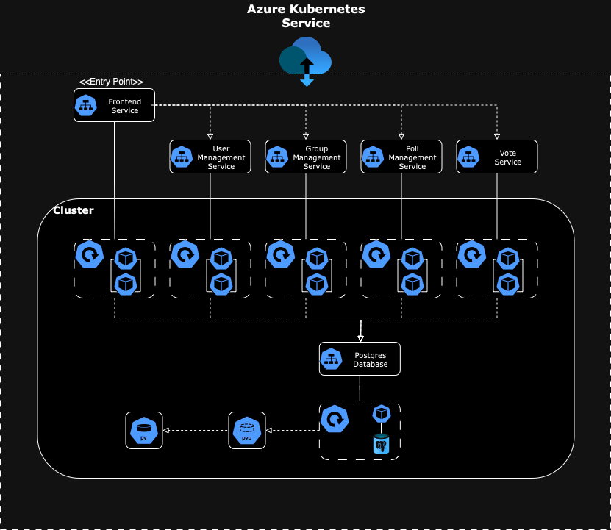

Slide 9
User roles

Slide 10

User roles
Standard user: Vote in polls, create polls, join or leave groups, and more.
Group moderator: Manage users rolls, resolving conflicts within the group, post notifications, approve or decline polls and delete polls.
Group Admin: Create and delete groups, edit group details, and modify moderator permissions.
System Admin: Ban or unban accounts, suspend accounts, and view private groups.

Slide 11
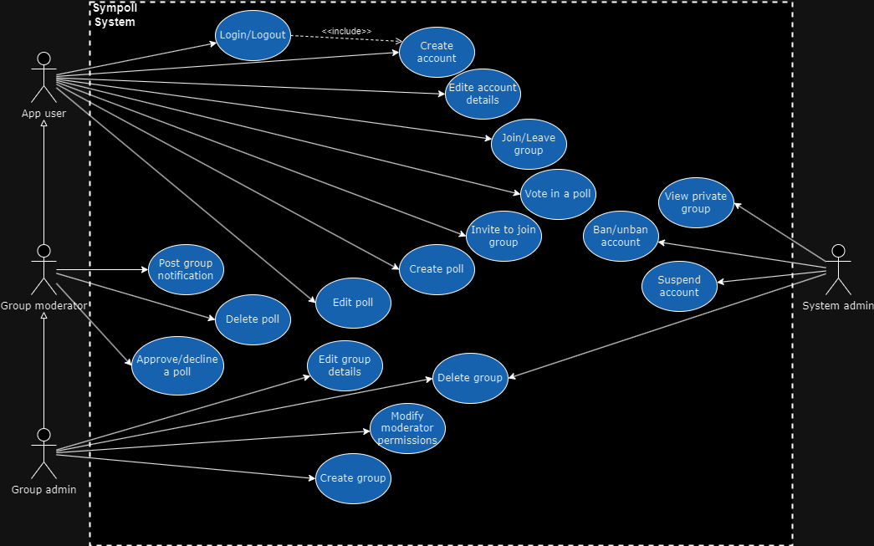

Slide 12
Database schema

Slide 13
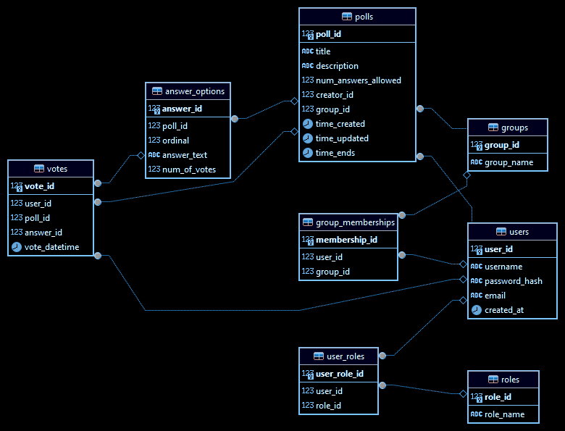

Slide 14
Frontend

Slide 15


Frontend
Technologies
• The programming language used for the frontend of the application is TypeScript, using React library to create a responsive and versatile single-page web application.
• Using React, the application will run in a single HTML page, while the content is updated dynamically as the user interacts with the application.
• The frontend service is built using the build tool Vite.
• The CSS styling of the web application written in the language of SASS, which is a cleaner and more efficient than simple CSS.

Slide 16
Frontend
Design
• The web application will be divided into the following pages components, that the app will switch between according the the user’s interactions.
• Each page will be created from multiple micro-components, that can be used throughout the application and that are not linked to a single page.
• There will be pages that are locked to specific user roles, such as system admins and moderators. These pages will allow these users to manage the system and the various groups and its contents.
• Each standard user will be able to access only the groups that he has joined, see and interact with their content of polls and posts.

Slide 17
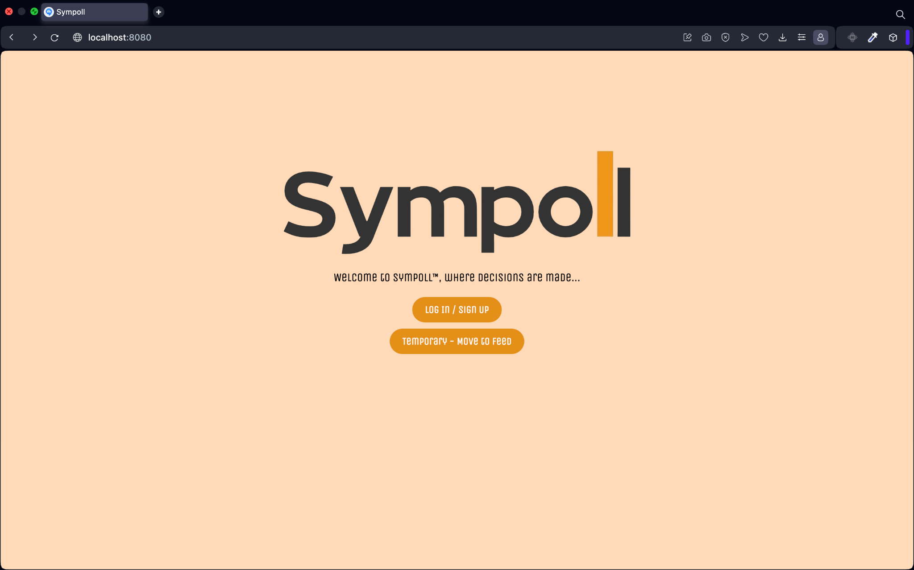
Frontend
Landing Page
The welcome page of the app. From this page the user may choose to sign-in or sign-up to start using the app.
Move to the Login/Signup Page
Temporary button to move to the Feed Page

Slide 18
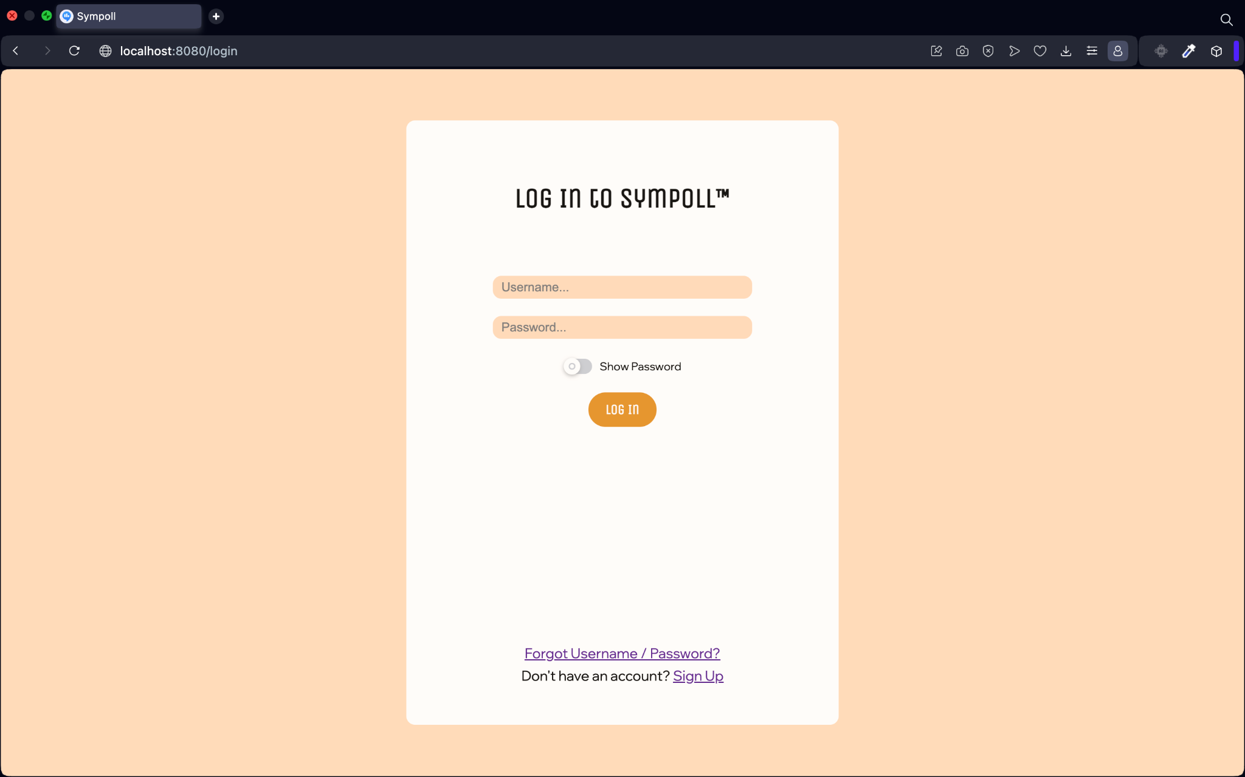
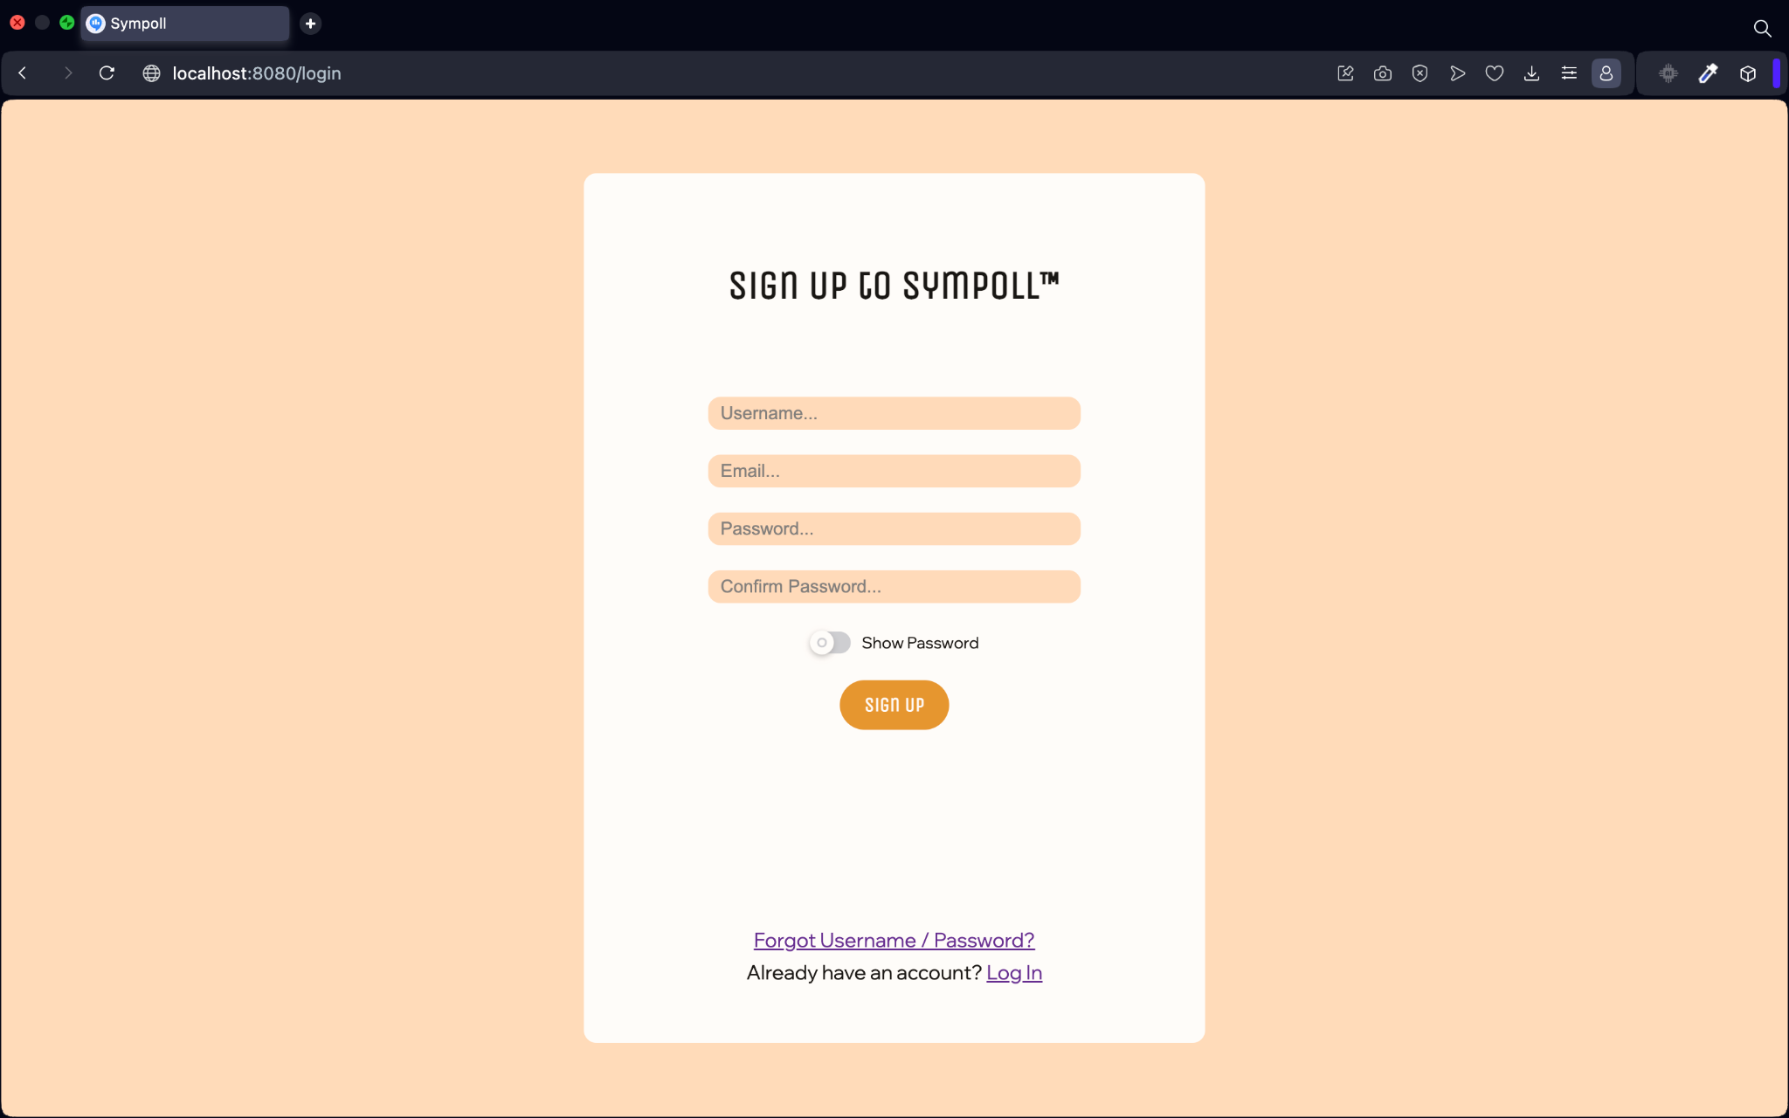
Frontend
Login/Signup Page
The user may choose to sign-in into an existing account using his username and password, or create a new account choosing a new unique username, a password and with his email.
Perform Login
Move to reset password form
Dynamically switch components to Sign Up
Perform Sign Up
Move to reset password form
Dynamically switch components to Login

Slide 19
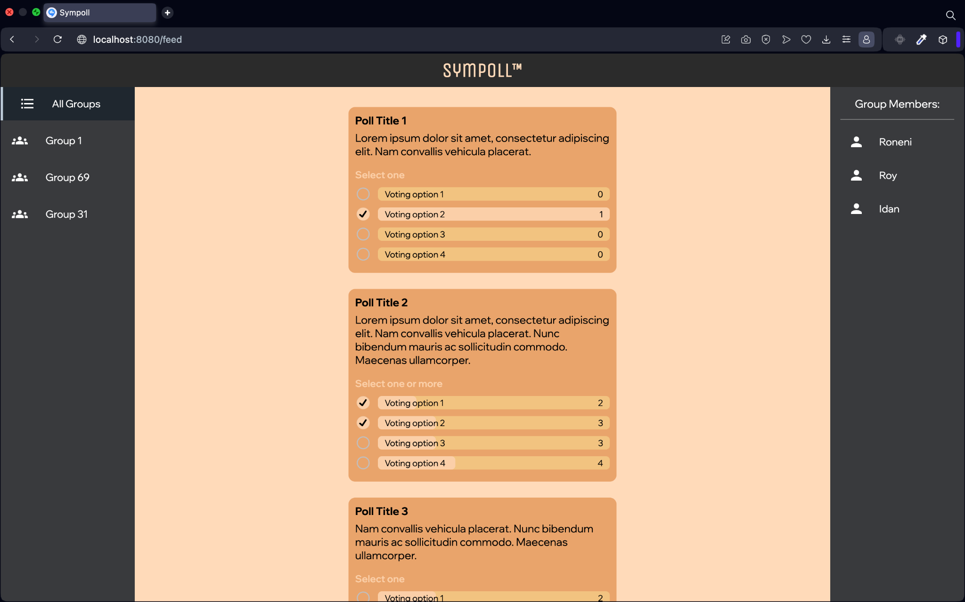
Frontend
Feed Page
This is the main page of the application, where the user may view his voting groups, view the chosen group’s members (other users), vote on polls and more, in a scrollable feed, the most recent polls will be on top.
Groups the user joined
Members of the chosen group
Voted for option 2
Voted for options 1,2

Slide 20
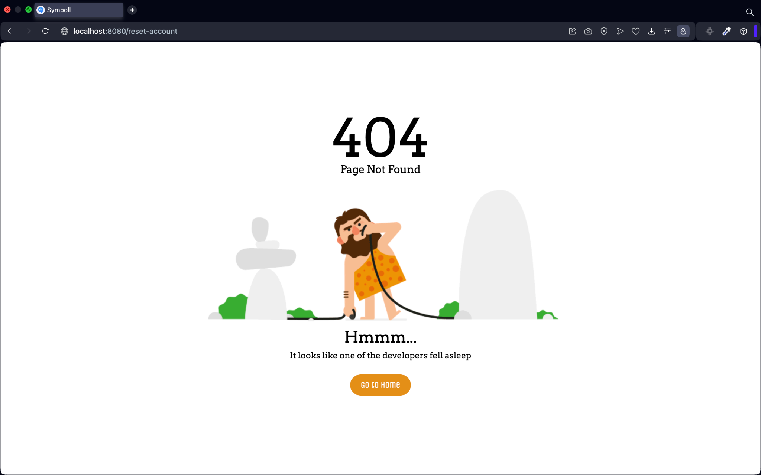
Frontend
“Page Not Found” Page
When a user enters a wrong endpoint such as “reset-account”, that there is no existing page of its name, the user will enter this page, that contains an option to return to the Landing Page.
Wrong Endpoint entered
Return to Landing Page

Slide 21
Frontend
Profile Page
Includes all information about the user - Email, profile picture, full name, with an option to edit and update.
Group Management Page
Where a group admin / moderator can edit the group’s info, add/remove members, change the group’s settings and behavior etc.
Working on it…

Slide 22
Backend

Slide 23


Backend
Technologies
Spring Boot, Postgres DB.
Java-based Spring Boot application with four main services:
Poll Management Service: Manages polls, questions, options, deadlines.
Voting Service: Processes votes, stores and retrieves voting data.
Group Management Service: Manages groups, tracks memberships.
User Management Service: Handles registration, authentication, authorization.
Design
Shared Objects (Core): Core system Java objects library for polls, users, groups, votes.
Shared Objects (Entities): Postgres entities library for polls, users, groups, votes.
Libraries

Slide 24
Working Practices

Slide 25


Working practices
Work management
Project task management is done using Trello, a kanban-style, list making application.
Currently there are 4 boards: Backend, Frontend, Project planning and Workshop tasks.
Automation
A service's container image is automatically created upon a push to the main branch in the GitHub repository, using GitHub Actions.
Container images and project libraries are stored under organization’s Github packages.
Version Control
Each service has its own repository, and all repositories are managed under a GitHub organization.
A release requires the approval of at least one other team member and is tagged with a version for ease of rollback if necessary.

Slide 26
Any Questions?

